Slide 1
INTRODUCTION TO
SURVIVAL ANALYSIS
And CASE 7

Slide 2
USES OF SURVIVAL ANALYSIS
Predicting time until event—dealing with those that have not had the event
churn
purchase
response
path
Predicting order of product purchases
competing risks
Insights into what independent variable pushes out / brings in time until event
Lifetime value
descriptive
predictive

Slide 3
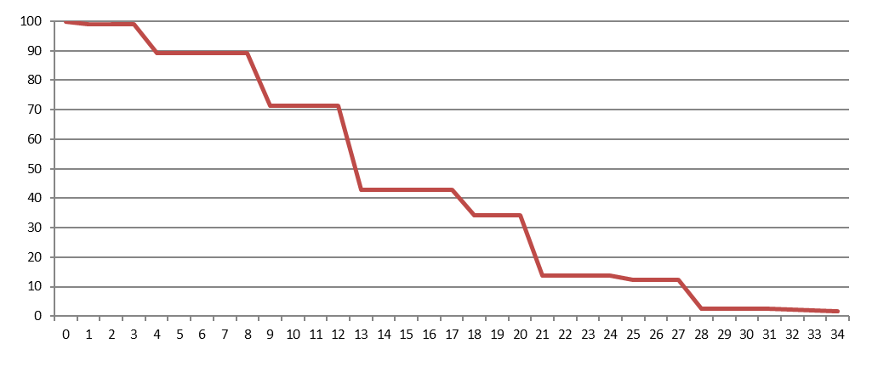
WHAT IS
SURVIVAL ANALYSIS?
censored
churned
TIME UNTIL EVENT
censored
customers
churned
start
now
% at risk
time

Slide 4

WHAT IS
SURVIVAL ANALYSIS?
Invented in 1972 by Sir David Cox
  Paper called “Regression and Life Tables” in Royal Journal of Statistics
  Came from bio-statistics
  Studying time-until-event problems, especially where death was the event
  Time-until-event studies posed statistical problems:
    Embedding time
    Dealing with censored observations
Breakthrough
  Creating proportional hazard technique
    Semi-parametric
    Partial likelihood
Survival analytics
  Life tables, life regression and PH regression
  Continuous time vs. discrete time

Slide 5
SIMPLER CHOICES FOR
SURVIVAL ANALYSIS?
THE CASE FOR ORDINARY REGRESSION
  What to do with time-until-event
  What to do with censored observations, i.e., those that did not have the event
THE CASE FOR LOGISTIC REGRESSION
  What to do with time-until-event
  What to do with censored observations, i.e., those that did not have the event

Slide 6
TYPES OF
SURVIVAL ANALYSIS
LIFE TABLE
  A plot of % at risk over time, essentially a plot of the survival curve
  Both discrete and continuous time
LIFE REG
  A regression, fitting independent variables to the survival curve
  Censoring: right only, time varying independent variables: no
  Distribution choices: lognormal, gamma, weibul, negative logistic, exponential, etc.
  Both discrete and continuous time
PH REG
  A regression, fitting independent variables to the hazard rate
  Censoring: all, time varying independent variables: yes
  Distribution choices: irrelevant
  Both discrete and continuous time

Slide 7
FROM ORDINARY REGRESSION
To Logistic Regression
TO COX REGRESSION

Slide 8
DIFFERENCES IN
DEPENDENT VARIABLE
Ordinary regression (OLS)
  Continuous, can take on any value
Logistic regression
  Binary, 1= had the event, 0 = did not have the event
Cox regression (Proportional hazards) and life reg
  Life reg = Survival curve, time until event
  PH = number of events per time period

Slide 9
DIFFERENCES IN
OPTIMIZATION TECHNIQUES
Ordinary regression
  Minimizes the sum of the squared residuals (OLS)
  This is a mathematical optimization problem
Logistic regression
  Maximum likelihood
  Fully parametric:
      Requires a functional form
      and an assumption of the distribution of the dependent variable
    What value of the coefficients maximizes the likelihood of observing the behavior of the dependent variable
    This is a grid-search problem, not a mathematical optimization problem
Cox regression (Proportional hazards)
  Partial likelihood
    Uses only the exponetiated coefficients for maximization
  Semi-parametric
      Does not require a distribution of the dependent variable, only functional form

Slide 10
DIFFERENCES IN
COEFFICIENT INTERPRETATION
 | PRICE | e^B | -1 | *100 | # avg (5)
ORDINARY REGRESSION | -0.250
LOGISTIC REGRESSION | -0.250 | 0.780 | -0.220 | -22.048
SURVIVAL ANALYSIS (LIFE REG) | 0.250 | 1.283 | 0.283 | 28.284 | 1.414
 |  |  |  | % change | avg change
Ordinary regression: price coefficient -0.25
  As price increases by 1 unit, predicted dependent variable decreases by 0.25 units
Logistic regression: price coefficient -0.25
  e**-0.25 = 0.779, as price increases by 1 unit, predicted probability of the dependent variable decreases by 22.1%
Cox regression (life reg NOT PH Reg): price coefficient 0.25 and average = 5 days
  [(e**0.25)-1)] * 5 = 1.414, as price increases by 1 unit, the predicted time until the dependent variable increases by 1.414 days
  Note that PH Reg would be negative instead of positive

Slide 11
TELECOMM CLIENT
PROBLEM:
How to predict churn
BUSINESS OBJECTIVE:
Provide a list of 60-day churners
Needs to be large enough and accurate enough to market against

Slide 12
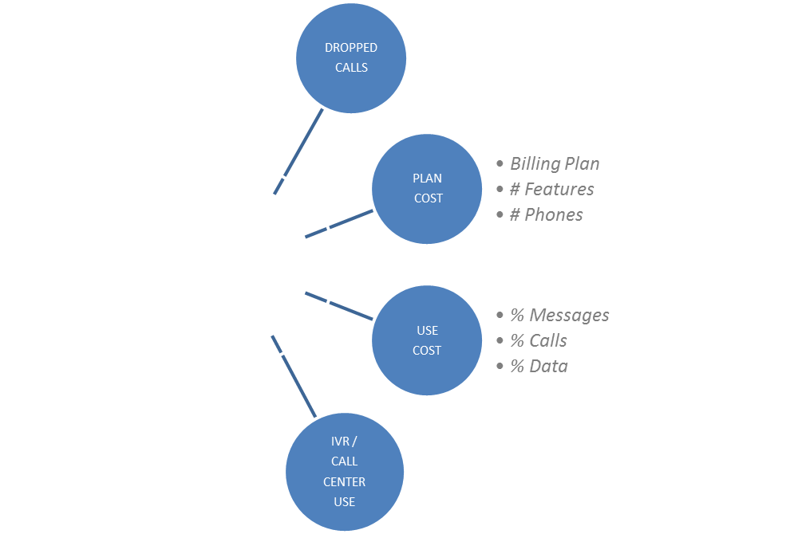
BACKGROUND
95% turnover per year!
In order to predict churners,
first must understand churners
CAUSES OF
CHURN

Slide 13
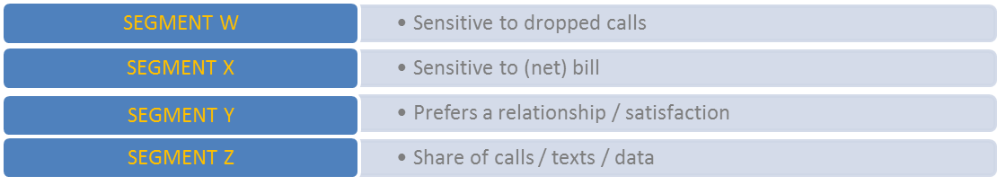
TELECOMM CLIENT
ANALYTIC SOLUTION
Behavioral Segmentation
Using behavioral data (things that cause churn) segmentation was applied
Each segment was sensitive to, or motivated by, different combinations of things:
Survival Analysis
This is a technique specifically designed to understand time-until- an-event, in this case, time until churn
A different survival model was applied to each segment to exploit behavioral differences
1.
2.

Slide 14

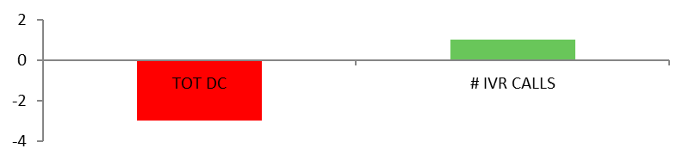
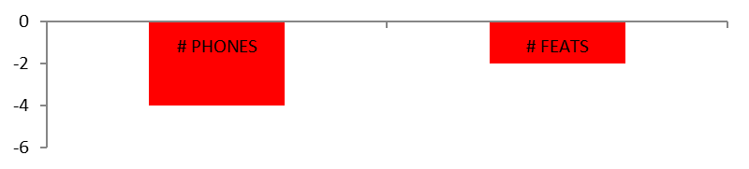
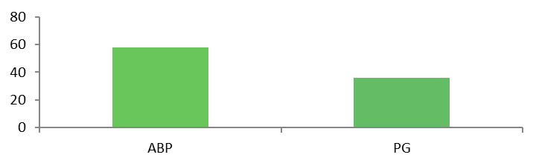
Survival Model Results
MISCELLANEOUS DIMENSION
Segment Characteristics
8% of the market, 9% of the revenue
Average tenure, 6.1 months
Lowest plan amount
Next to longest average call duration
Largest decrease in amount changed
Next to lowest bundle
Largest share of calls
Get all possible on ABP and Paygo.
Discourage adding phones.
BEHAVIOR DIMENSION
BILLING DIMENSION

Slide 15

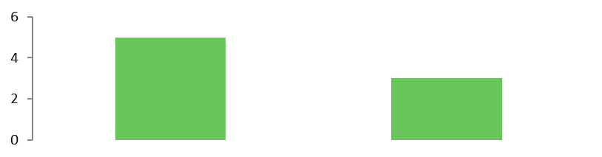
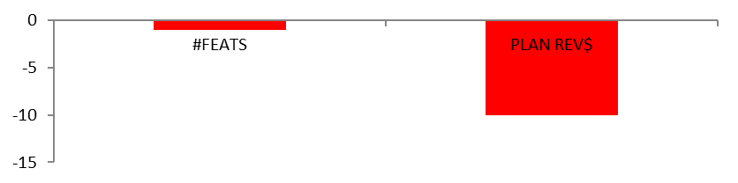
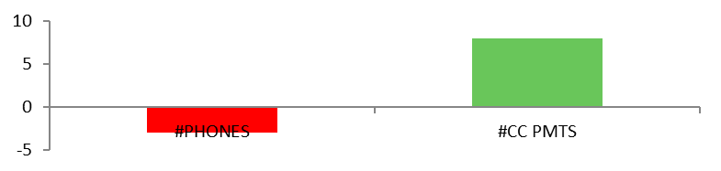
Survival Model Results
Segment Characteristics
5% of the market, 12% of the revenue
Next to longest tenure, 8.9 months
Highest average revenue / customer
Longest IVR duration
Next to most IVR calls
Next to highest household income
Revenue % / customer % is 2.5
Socialize IVR and discourage increased number of phones.
MISCELLANEOUS DIMENSION
# IVR CALLS COUP ADJ
BILLING DIMENSION
BEHAVIOR DIMENSION

Slide 16
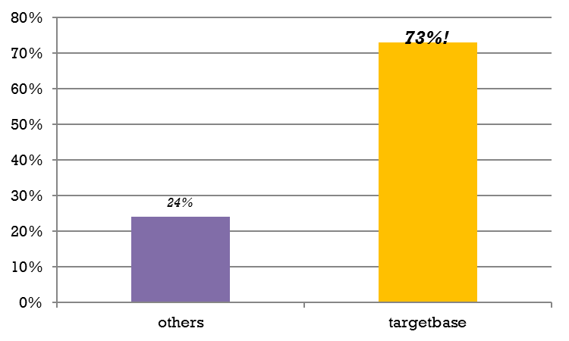
TELECOM CLIENT
ANALYTIC RESULTS
60-Day Accuracy List
Telecom client is now field testing this model
using segment sensitivities as strategy
That is, one segment receives a call about dropped calls, another receives a message about a better billing plan, another receives a coupon adjustment, etc.
Impactful to the business

Slide 17
LIFETIME VALUE
Typically descriptive calculation
  No insights
  No strategy
Survival Analysis provides both
  Business case for changing price, etc.

Slide 18
CASE 7 predictive lifetime value
BY SEGMENT:
  How does product penetration affect LTV?
  How does discounting affect LTV?
  How does number of direct mail and email affect LTV?
Need strategy by segment of which segments to go after
Need strategy by segment how to maximize LTV
Need test plan
Need financial implications

